Slide 1
Safe Sources
Team 1B: Divisha Jain, Cailin Dech, Yandel Gonzalez, Oswaldo Olivares, Joshua Connolly Mentor: Jillian Lim
Notes:
Hello this our team project SafeSource. Safesources is an app that helps you check sites to see that there reliable.
Cailin => Kay-Lin

Slide 2
Theme: Role and Reliability of Social Media in Information Sharing
Our goal with Safe Sources is to provide an app for students, teachers and computer-users to help find reliable sources when researching online.
Unreliable Sources
Credible Sources
New sites that spread false information
Sites that have .edu and .gov
Social media such as Twitter and TikTok
Sites with academic papers like Google Sources and JSTOR
Notes:
Why did you choose to focus on this particular problem?
We chose it because we want to use reliable and trustworthy websites while writing research papers
Some examples of unreliable sources are new sites and social media, some examples of credibles sources are like school and the government sites and academic research sites
Some unreliable sources are New sites and Social Media and some reliable sources are sites that have edu. And gov and sites with academic papers

Slide 3
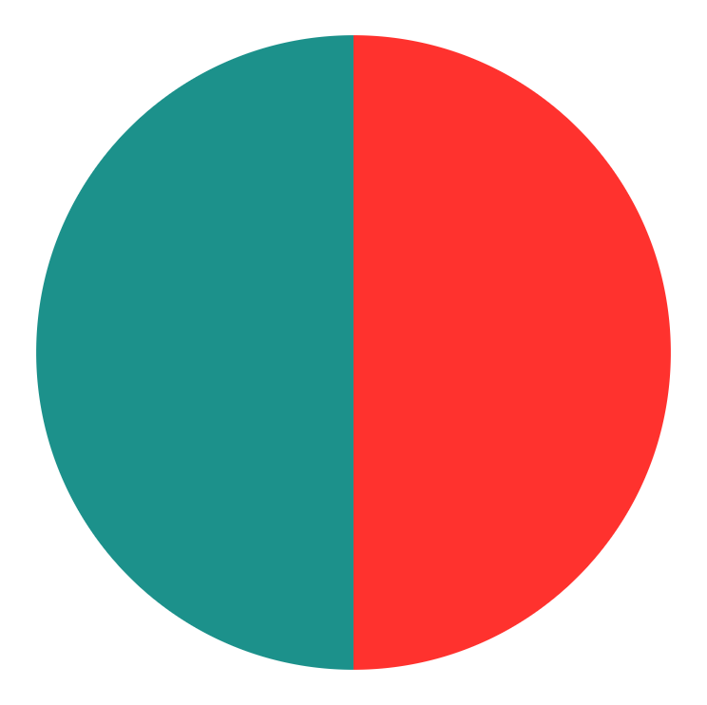
Market Research
< 18
50%
50%
18-25
Half of the people who did the questionnaire was under 18 years of age.
Half of the people who did the questionnaire was between 18 and 25 years of age.
Notes:
We conducted a small survey with 20 people
IDENTIFY END USERS:
Your end-users: Who does it affect and how?

Slide 4
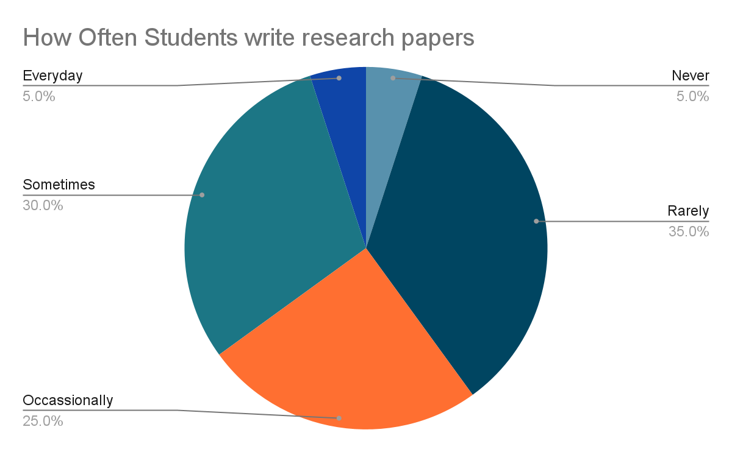
Notes:
Don’t include percentages of the graphs- Ex. below
95 of students actually do write some kind of research papers while the graph indicates that only 5% don’t

Slide 5
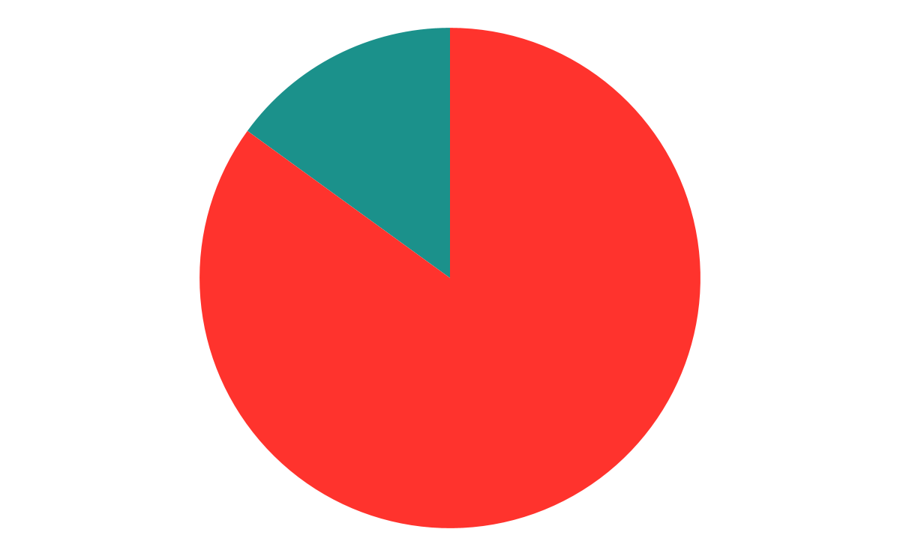
Would you search information up several times over to make sure it was correct?
Maybe
15%
85%
Yes
15% were unsure if they had to continuous see if the information they found was correct
85% would make sure to validate information several times over.

Slide 6
The Problem With UNRELIABLE SOURCES
Problem 1
Problem 2
Problem 3
Students using unreliable sources in their research papers make the information incorrect and make their paper weaker
Unreliable sources can create confusion and misunderstanding about the research topic
Unreliable sources are hard to detect because students do not have equal access to resources to help them identify them
Notes:
-Summarize it more; “The problem with unreliable sources is that it a) causes their paper seem weaker and unreliable, b) create confusion and misunderstanding about the topic, and c) students don’t have equal access to identify what’s reliable and not. “

Slide 7
Possible Solutions
Website Checker
1
A way for users to check if their sources are credible or Non-Credible
Chat with Experts
2
A way for users to get any help from experts
Add to the Database
3
A way for users to add what they believe is a credible source to the database, and cross-check with experts
Notes:
-Giving people opportunity to check if their sources are reliable, giving other peoples opinions with the chat and stuff, they can also put their own sources that are credible in the app,

Slide 8

App Demo
Notes:
https://drive.google.com/file/d/1fG0sE1xQp1tcUugpCPfxEgiGWwAM-G2e/view?usp=sharing

Slide 9
AI Matrix
Respect for: | Well-Being | Autonomy | Fairness
Students | Learn how to find credible websites for school research or projects | Students can learn how to find reliable sources independently | All Students can have equal access to our app for free.
Teachers | Be able to teach Students how to identify credible sources with the help of our app |  | All teachers can teach students the same things about credible sources from our app
Computer-User | Be able to find credible sources when they are looking at the internet |  | Can learn about credible sources regardless of education

Slide 10
Competitive Analysis
IONOS Website Checker
Ryte
Internet Source Checker
This app makes you fill out a survey about your website and gives you a brief description about it.
The IONOS website checker gives you a percentage on 4 aspects
This app gives you an overall percentage on how well your website works. This app also further divides into 4 aspects.
One thing all these apps have in common is they don’t tell you if the information on the app is reliable or not.
Notes:
Moving on to Competitive analysis, we have found 3 competitors. IONOS, Ryte and Internet Source Checker
-One thing all these apps have in common is they don’t tell you if the information on the app is reliable or not.
But the main question here is Why is Safe Sources better? The other three aps dont tell us where they are getting their information from but our app will tell you if the website is credible or not based off a database that is built from experts and users More
.

Slide 11
Future Directions
Make sure to detect specific sentences of information that is true instead of saying the whole website is fake.
Add a more interactive feature like a leaderboard.
1
2
Apply rules that Websites have to follow to make sure if a website is reliable/legit or not.
Teach people how to spot Unreliable Sources Themselves.
3
4
Stop The Creation of Unreliable Websites in the first place.
Notes:
Some Future Directions For our app are Adding a more interactive aspect in our app like a leader board to count how many reliable apps people have posted. Another thing we can add in the future is a Fact Checker that tells you if a certain fact is true or false. And not just to Advance our app, we can try to stop the making of Fake websites by applying rules websites must follow. We can also teach people in the future how to spot Fake news On The Internet themselves. Our Main goal for our app and its purpose is To Stop the Creation of Unreliable Websites. THank you for listening, are there any questions.

